Slide 1

HS-202 | HUMAN GEOGRAPHY AND SOCIAL NEEDS
W
Sustainable
Water
Management
GROUP 2 | PRESENTED BY
AKSHIT KUMAR
RITHWIK CHANDER
Notes:
1

Slide 2
65%
THE
PROBLEM
Face irregular water supply
75+
Water scarcity is not uniform — it varies by climate, geography, and resource availability.
Survey participants
3
Major solution categories
Notes:
2

Slide 3
03 — PROBLEM STATEMENT
FOG
Fog & Moisture Underutilized
IoT
No Real-Time Sensing
Hilly regions and North India have thick winter fog — yet this moisture stays uncollected due to lack of practical systems.
Humidity, TDS, temperature & air quality data is rarely gathered, limiting optimization of water harvesting.
AQI
Pollution Risk
GAP
Awareness Gap
In smoggy conditions, atmospheric pollutants affect harvested water purity — monitoring systems are essential.
People are unaware of alternatives like fog collection, radiative dew harvesting, and AI-guided systems.
KEY FINDING: Water scarcity is not only about lack of resources — it's a mismatch between regional conditions and solutions applied.
Notes:
3

Slide 4

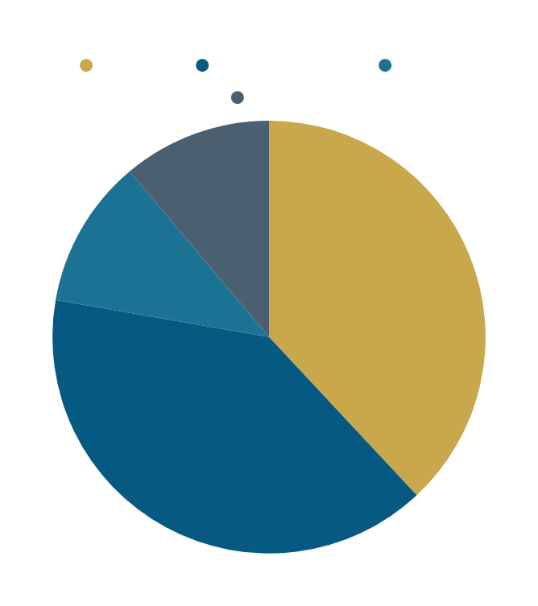
SURVEY
INSIGHTS
75 respondents — students + local farmers
Notes:
4

Slide 5
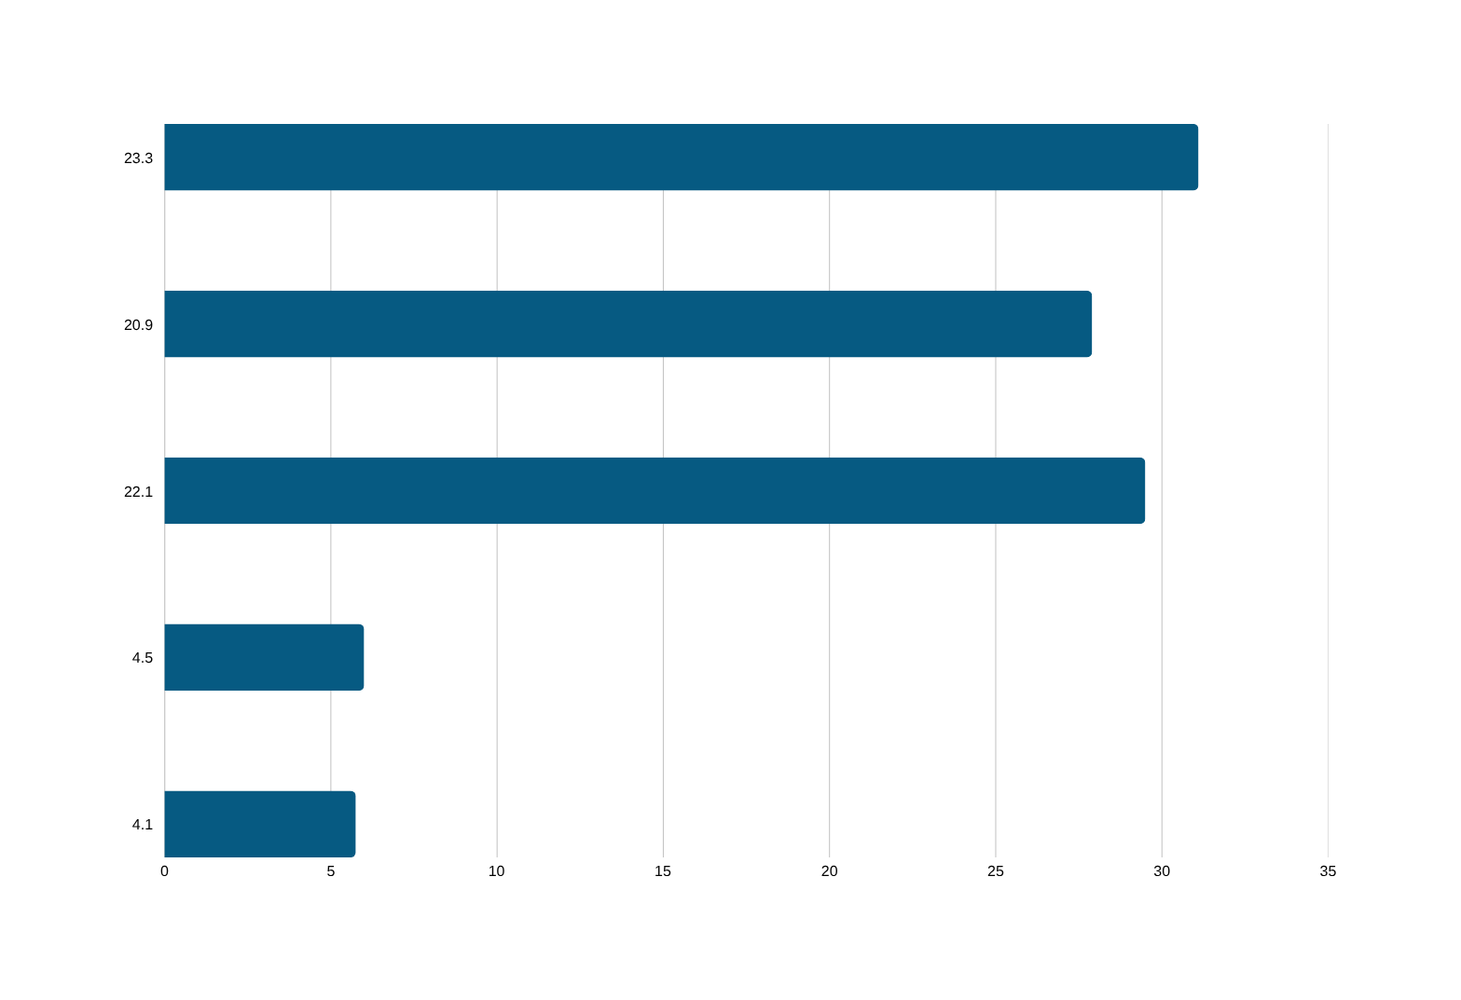
04 — CAUSES OF WATER SCARCITY IN INDIA
Agricultural overuse (tube wells, paddy,irrigation,grounwater)
population growth and urban demand
Poor water management policies
Industrial pollution
Climate change and rainfall variability
Notes:
5

Slide 6
08
CURRENT DEVELOPMENTS IN FOG WATER HARVESTING
01
BIO
02
3D
03
IoT
Biomimetic Mesh
3D Spacer Fabrics
IoT Smart Monitoring
Inspired by the Namib Desert beetle and cactus spines — Janus membranes with hydrophilic tips and hydrophobic valleys dramatically increase water capture.
CloudFisher-style 3D mesh grids withstand 120 km/h winds. Prevent water loss from flapping and greatly reduce maintenance.
Real-time sensors for wind speed, humidity & water yield. Continuous data enables efficiency calculation, damage detection & supply prediction.
Notes:
6

Slide 7
15
PRIMARY
GOAL
GOALS &
OBJECTIVES
Create region-specific, AI-guided atmospheric water harvesting systems for sustainable water management.
01
Build a radiative dew & fog harvesting system to collect surplus atmospheric moisture
02
Analyze environmental variables (humidity, temp, TDS, air quality) via sensors
03
Monitor and analyze water quality using TDS and turbidity sensors
04
Develop AI/ML algorithms for predictive analytics and weather-based optimization
05
Build a working hardware prototype and validate in simulation environments
Notes:
7

Slide 8
18 — IMPLEMENTATION APPROACH
H
DHT11
SM
YL-69
R
FC-37
WL
HC-SR04
Humidity
Soil Moisture
Rain Detection
Water Level
T
LM35
TD
TDS
TB
Turbidity
WF
YF-S201
Temperature
Water Purity
Water Clarity
Water Flow
INPUT
Sensors
PROCESSING
Arduino
DECISION
Rule-Based AI
OUTPUT
Action / Alert
->
->
->
Notes:
8

Slide 9
EXPECTED OUTCOMES
Save
10-20%
AI
AI
IoT
IoT
Reduction in water wastage through real-time decision-making
Powered recommendations for region-specific water harvesting methods
Integrated sensors enabling smart, continuous environmental monitoring
ML
Data
All
Scale
Edu
Aware
Foundation for future ML/AI predictive algorithms for weather & water
Applicable in farming, home gardening & institutional settings
Increased community awareness of alternative water harvesting methods
Notes:
9

Slide 10
CONCLUSION
Bridging the gap between environmental potential and effective water solutions.
Surveys revealed a clear awareness-implementation gap in water management
Fog & dew harvesting is feasible but requires smart, sensor-based systems
AI-guided, region-specific approaches outperform one-size-fits-all methods
Collaboration between government, researchers & communities is essential
Modern tech + traditional methods + affordable access = Sustainable water future
HS-202 | Human Geography and Social Needs | Group 2
Notes:
10

